Slide 1



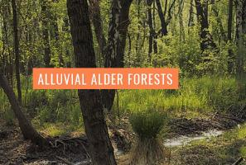
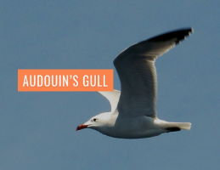
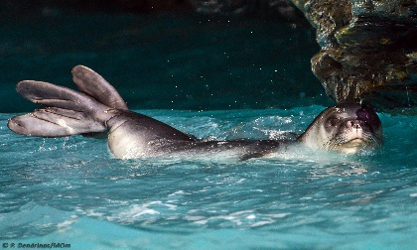
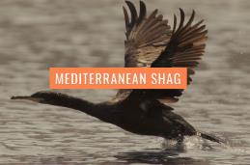

ACTION A.4. Socio-economic analysis to identify the vulnerabilities and opportunities for the sustainable development of Andros Natura 2000 sites
“Conservation of priority species and habitats of Andros Island protected area integrating socioeconomic considerations”
“LIFE Andros Park”, LIFE16 NAT/GR/000606
Notes:
NOTE:
To change the image on this slide, select the picture and delete it. Then click the Pictures icon in the placeholder to insert your own image.

Slide 2


ACTION A.4 - Overview
Deliverables | Deadline | Status
Policy brief | 06/2018 | Completed
Best practice guide for policy makers and local stakeholders | 10/2018 | Completed*
Manual for the establishment of Andros Brand | 12/2018 | Completed**
Technical plan for the establishment of ecotourism/fishing tourism info desk | 12/2018 | Completed***
“LIFE Andros Park”, LIFE16 NAT/GR/000606

Slide 3
ACTION A.4 - An insight into deliverables
1. Policy Brief - “Building resilience in small island economies: an insight into Andros lsland”
Context of small island economies: the case of Andros Island
Vulnerabilities and opportunities for the sustainable development of the Andros Island Natura 2000 sites
Building resilience and strengthening sustainable development
The way forward and key implications for policy (recommendations)
Methodology: stakeholder in-depth interviews, deliberative group discussions, SWOT analysis, literature review

Slide 4
ACTION A.4 - An insight into deliverables
2. Best Practice Guide for Policy Makers and Local Stakeholders
Introduction
Main steps for the development of sustainable tourism in a protected area
Συμμετοχή της τοπικής κοινωνίας και όλων των ενδιαφερόμενων μερών
Δραστηριότητες ενημέρωσης και περιβαλλοντικής εκπαίδευσης
Αναπροσαρμογή
Διάγνωση
Σχεδιασμός στρατηγικής
Υλοποίηση
Προβολή
Σύσταση ‘φορέα’ ή επιτροπής σχεδιασμού του οικοτουρισμού
Συνεχής παρακολούθηση και αξιολόγηση

Slide 5
ACTION A.4 - An insight into deliverables
2. Best Practice Guide for Policy Makers and Local Stakeholders (continued)
Examples of sustainable development in Greece and other European countries
Socio-economic importance and sustainable development of Natura 2000 sites in Andros: stakeholders’ perceptions
Conclusions
Methodology: literature review, stakeholder engagement (in-depth interviews, deliberative group discussions in Andros)
*Comment: Deliverable although completed could benefit from partners’ review regarding case studies/examples and ecosystem services context

Slide 6
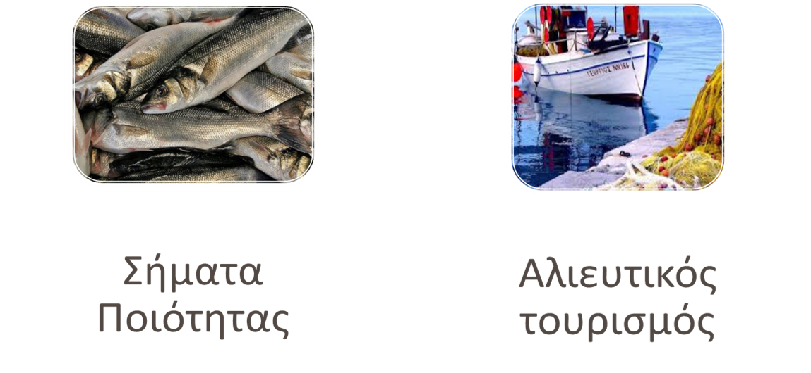
ACTION A.4 - An insight into deliverables
3. Manual Including a Business Plan for the Establishment and Operation of Andros Brand
The following tow actions are proposed:

Slide 7
ACTION A.4 - An insight into deliverables
3. Manual Including a Business Plan for the Establishment and Operation of Andros Brand
Introduction
Main steps towards the design of a commercial brand
Benefits, challenges, drivers of success, best practices
Stakeholders’ perceptions and recommendations on the
creation of Andros Brand
Towards a high level business plan
Conclusions

Slide 8
ACTION A.4 - An insight into deliverables
3. Manual Including a Business Plan for the Establishment and Operation of Andros Brand (continued)
Methodology: engagement with selected experts (in-depth interviews) who have previous experience in quality branding (e.g., Samaria National Park , National Marine Park of Zakynthos, National Park of Nestos Delta and lakes Vistonida-Ismarida, WWF, University of Thessaly), literature review
**Comment: Deliverable’s sections on business plan and main steps are to be updated. More business plan related information is to become available while project progresses, while main steps section could be supplemented with information contained in the operational plan regarding fishers’ voluntary measures

Slide 9
ACTION A.4 - An insight into deliverables
4. Technical plan for the establishment of ecotourism/fishing tourism info desk
Introduction
Creating a common vision and strategy for fishing tourism-ecotourism
Meanings and principles
Interested parties
Tools and methods
Introduction to the Business Model Canvas
Next steps
Conclusions

Slide 10
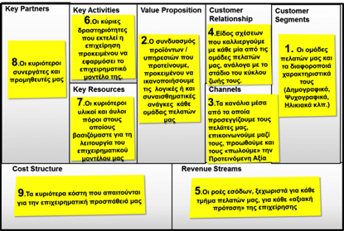
ACTION A.4 - An insight into deliverables
4. Technical plan for the establishment of ecotourism/fishing tourism info desk
Business Model Canvas (BMC)
Business Model Canvas

Slide 11
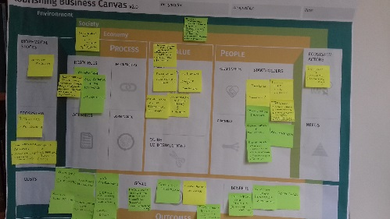
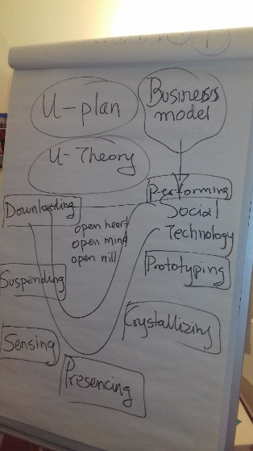
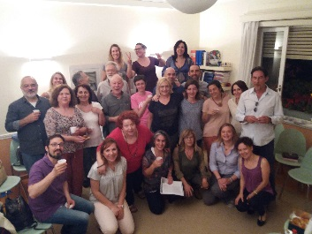
ACTION A.4 - An insight into deliverables
4. Technical plan for the establishment of ecotourism/fishing tourism info desk
A workshop is needed to refine the Business Model Canvas by sharing ideas with interested stakeholders
The refinement process includes
- An introduction to the BMC tool
- A brainstorming session
- Work in groups (parallel sessions)
- Debriefing session
PURPOSE: Identification of the preferred Business Model for Fishing tourism activities and the opening of a proactive discussion with all stakeholders

Slide 12
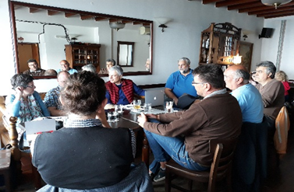
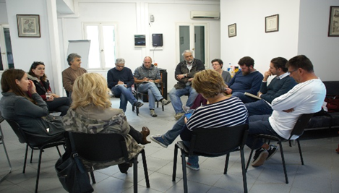
ACTION A.4 - Overview
Milestones | Deadline | Status
Organisation of the 1st workshop with stakeholders | 12/2017 | Completed
Organisation of the 2nd workshop with stakeholders | 05/2018 | Completed
“LIFE Andros Park”, LIFE16 NAT/GR/000606

Slide 13
Action E.3: Training workshops and seminars for key stakeholders
“Conservation of priority species and habitats of Andros Island protected area integrating socioeconomic considerations”
“LIFE Andros Park”, LIFE16 NAT/GR/000606
Notes:
NOTE:
To change the image on this slide, select the picture and delete it. Then click the Pictures icon in the placeholder to insert your own image.

Slide 14
ACTION E.3 - Overview
Deliverables | Deadline | Status
1st workshop agenda, minutes and list of participants | 09/2018 | Completed
2nd workshop agenda, minutes and list of participants | 09/2021
Training, seminar agenda, materials, list of participants | 09/2021
Alonnisos workshop | 09/2021
Karpathos workshop | 09/2021
“LIFE Andros Park”, LIFE16 NAT/GR/000606

Slide 15
Next steps
Measures to boost the collaboration and positive involvement of local stakeholders and change a potential local negative public opinion :
Collaborate with the local social enterprise in order to organise a photo elicitation walk for children in the Nature sites. A photo exhibition is to follow
Organise additional actions that enhance environmental education and awareness e.g., capture fishers’ narratives with regards to fishing tradition, knowledge etc, organise a theatrical play inspired by the conflict between seal conservation and fisheries
Working closely with NCC to identify and suggest actions to the local Centre of Environmental Education regarding fisheries and conservation
Working closely with MOm and NCC and MA and organize the BMC development session with local groups.

